Slide 1
Transaction Management
Dr. Parteek Kumar

Slide 2
What is Transaction?
A transaction is a set of changes that must all be made together.
Transaction is executed as a single unit. If the database was in consistent state before a transaction, then after execution of the transaction also, the database must be in a consistent state.
For example, a transfer of money from one bank account to another requires two changes to the database both must succeed or fail together.

Slide 3
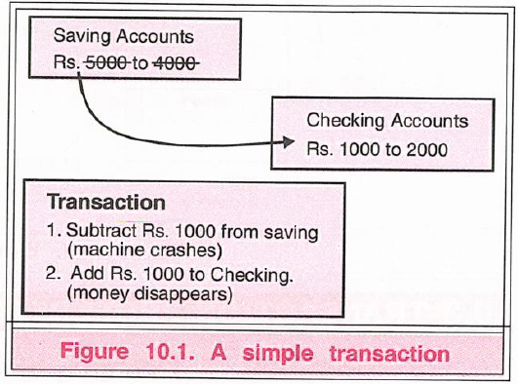
Example
You are working on a system for a bank. A customer goes to the ATM and instructs it to transfer Rs. 1000 from savings to a checking account. This simple transaction requires two steps:
❑ Subtracting the money from the savings account balance.
❑ Adding the money to the checking account balance.

Slide 4
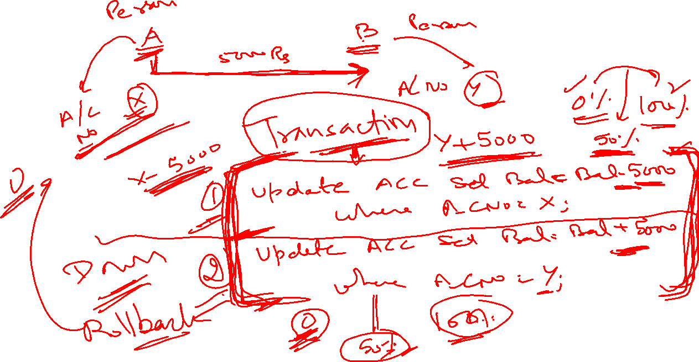


Slide 5
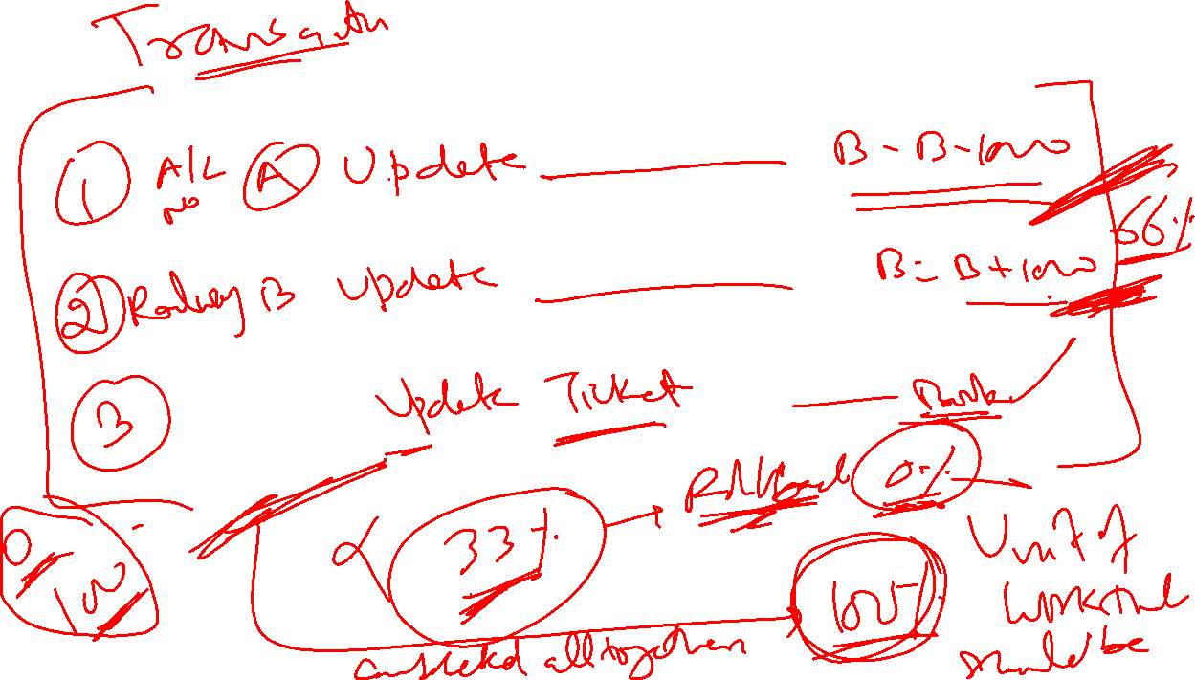


Slide 6
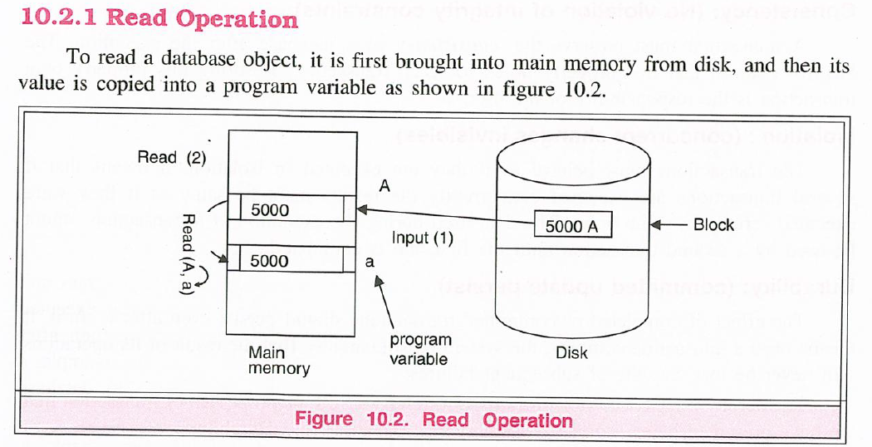
Processes of Transaction

Slide 7
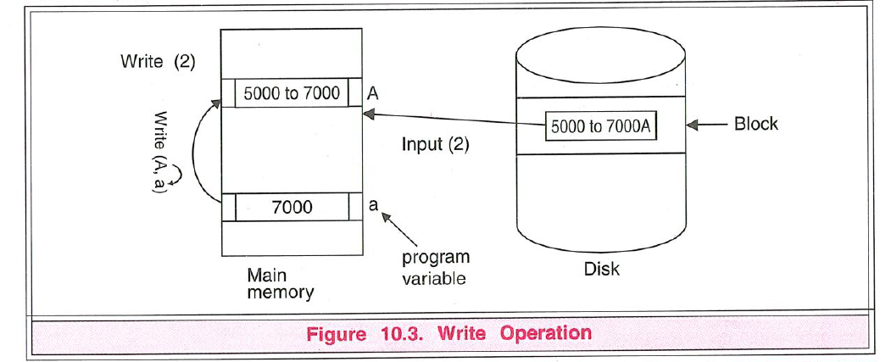

Slide 8
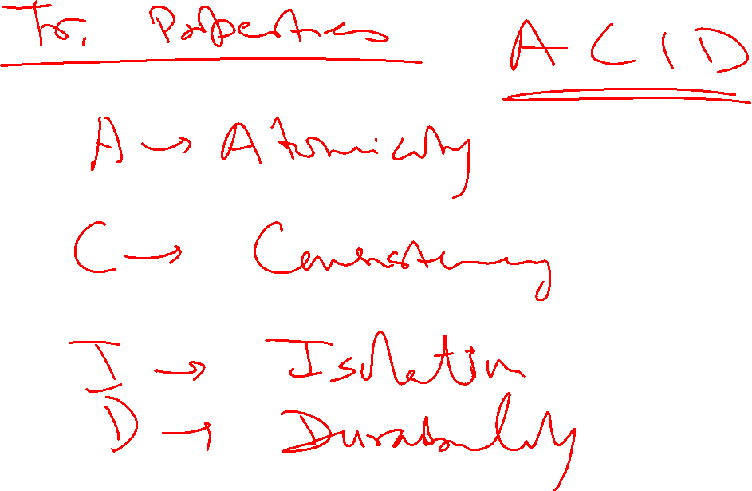

Slide 10
Transaction Properties:
Atomicity: (all or nothing)
A transaction is said to be atomic if a transaction always executes all its actions in one step or not executes any actions at all. It means either all or none of the transactions operations are performed.
Consistency: (No violation of integrity constraints)
A transaction must preserve the consistency of a database after the execution. The DBMS assumes that this property holds for each transaction. Ensuring this property of a transaction is the responsibility of the user.
Isolation : (concurrent changes invisibles)
The transactions must behave as if they are executed in isolation. It means that if several transactions are executed concurrently the results must be same as if they were executed serially in some order. The data used during the execution of a transaction cannot be used by a second transaction until the first one is completed.

Slide 11
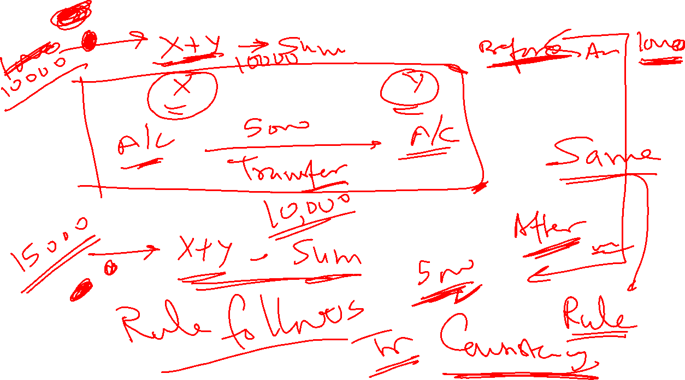

Slide 12
Transaction Properties:
Durability: (committed update persist)
The effect of completed or committed transactions should persist even after a crash. It means once a transaction commits, the system must guarantee that the result of its operations will never be lost, in spite of subsequent failures.
The acronym ACID is sometimes used to refer above four properties of transaction that we have presented here: Atomicity, Consistency, Isolation, and Durability.

Slide 17
Example
In order to understand above properties consider the following example:
Let Ti be a transaction that transfers Rs 50 from account A to account B. This transaction can be defined as:
T1 Schedule
Read (A,a)
a:=a-50;
Write(A,a)
Read(B,b)
b:=b+50;
Write(B,b);

Slide 18
Atomicity: Suppose that just prior to execution of transaction Ti the values of account A and B are Rs.1000 and Rs.2000.
Now suppose that during the execution of Ti, a power failure has occurred that prevented the Ti to complete successfully. The point of failure may be after the completion of Write(A,a) and before Write(B,b). It means that the changes in A are performed but not in B. Thus the values of account A and B are Rs.950 and Rs.2000 respectively. We have lost Rs.50 as a result of this failure.
Now, our database is in inconsistent state.
The reason for this inconsistent state is that our transaction is completed partially and we save the changes of uncommitted transaction. In order to maintain atomicity of transaction, the database system keeps track of the old values of any write and if the transaction does not complete its execution, the old values are restored to make it appear as the transaction never executed.

Slide 19
Consistency:
The consistency requirement here is that the sum of A and B must be unchanged by the execution of the transaction. Without the consistency requirement, money could be created or destroyed by the transaction. It can be verified easily that, if the database is consistent before an execution of the transaction, the database remains consistent after the execution of the transaction.
Ensuring consistency for an individual transaction is the responsibility of the application programmer who codes the transaction.

Slide 20
Isolation:
If several transactions are executed concurrently (or in parallel), then each transaction must behave as if it was executed in isolation. It means that concurrent execution does not result an inconsistent state.
For example, consider another transaction T2, which has to display the sum of account A and B. Then, its result should be Rs.3000.

Slide 21
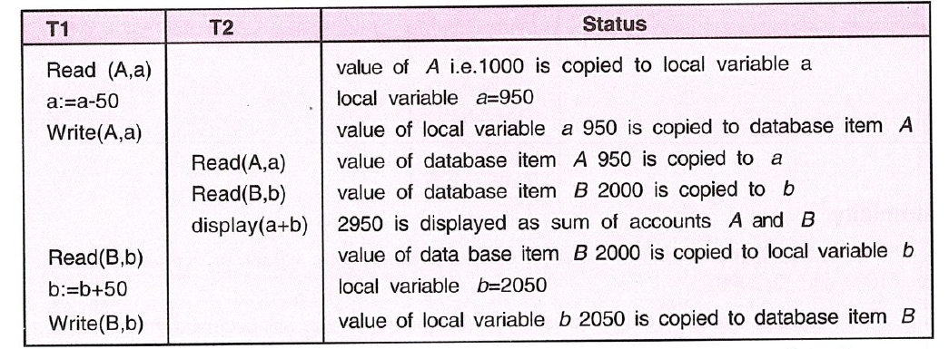

Slide 22
Durability:
Once the execution of the transaction completes successfully, and the user who initiated the transaction has been notified that the transfer of funds has taken place, it must be the case that no system failure will result in a loss of data corresponding to this transfer of funds.
The durability property guarantees that, once a transaction completes successfully, all the updates that it carried out on the database persist, even if there is a system failure after the transaction completes execution. Ensuring durability is the responsibility of a component of the database system called the recovery-management component.

Slide 23
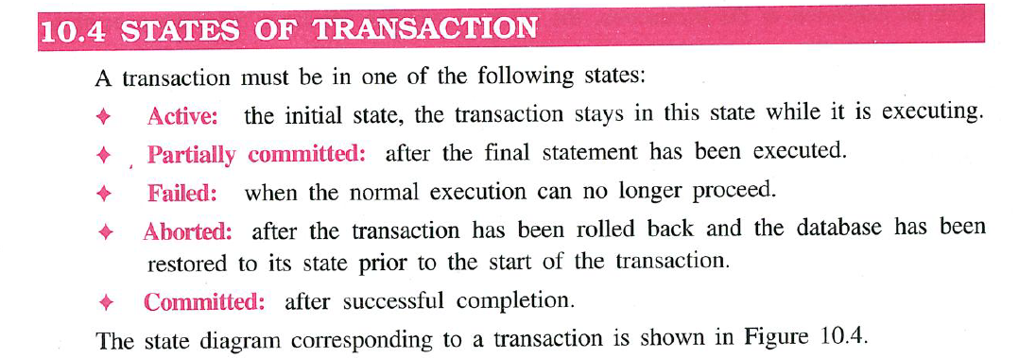

Slide 24
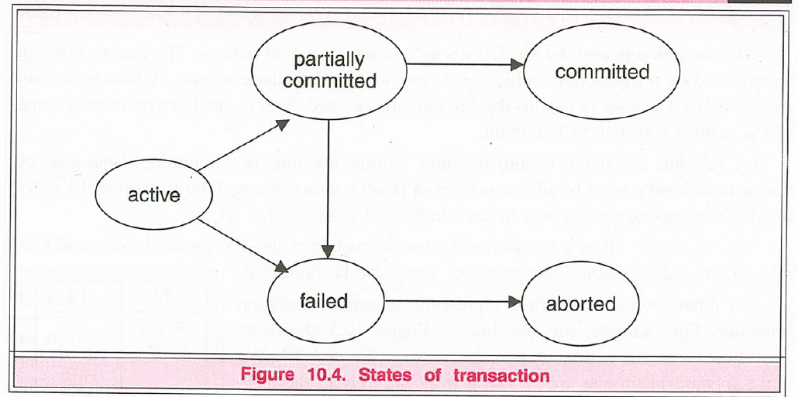

Slide 25
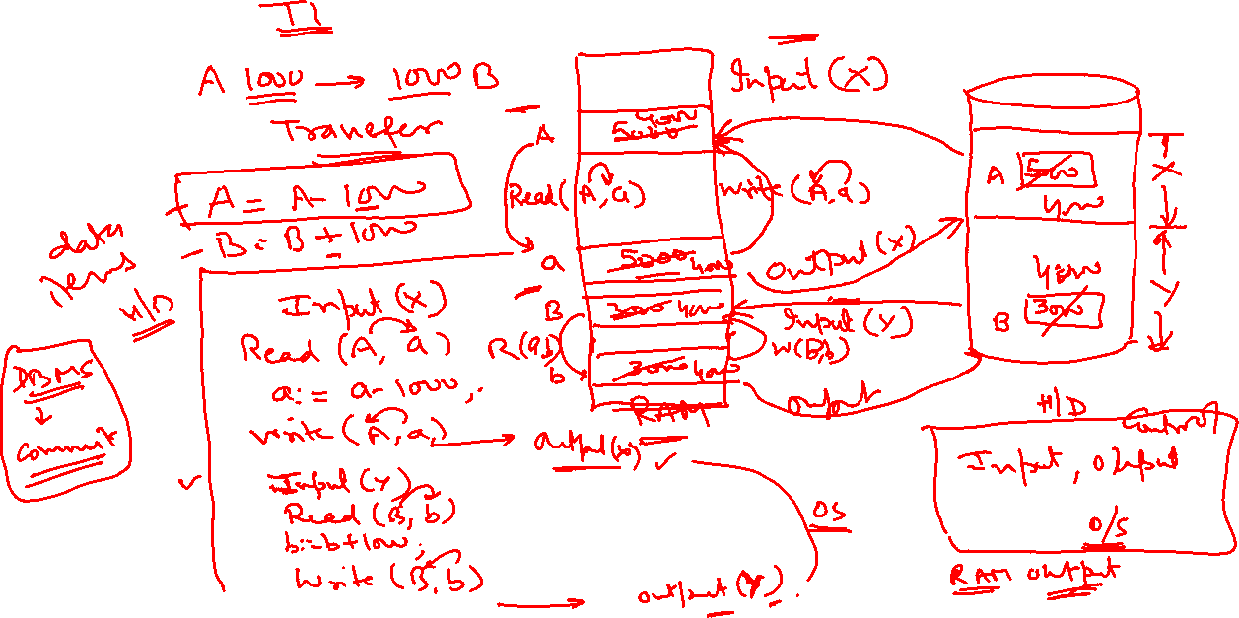

Slide 26
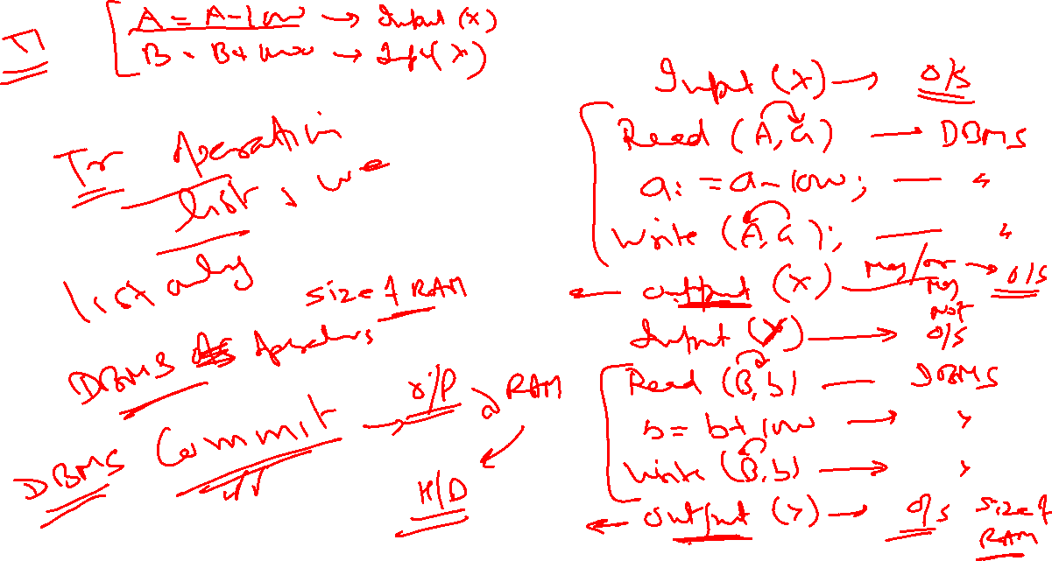

Slide 27
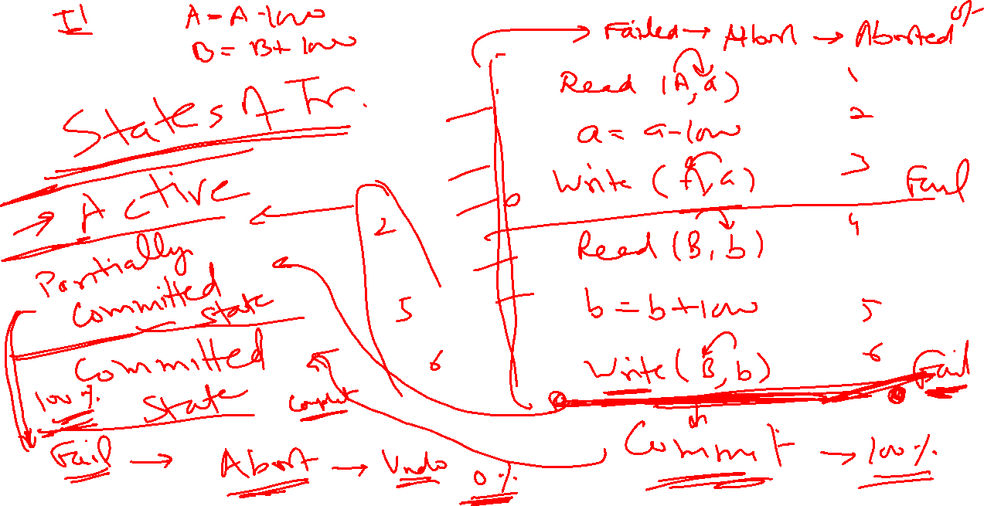

Slide 31
Advantages of concurrent execution of transaction
The DBMS interleaves the actions of different transactions to improve performance of system as discussed below:
❑ Improved Throughput: Consider that transaction are performed in serial order and active transaction is waiting for a page to be read in from disk, then instead of CPU waiting for a page, it can process another transaction. This is because Input/Output activity can be done in parallel with the CPU activity. The overlapping of Input/Output activities of CPU reduces the amount of time disks and processors are idle and increases system throughput (the average number of transaction completed in a given time.)
❑ Reduced Waiting time: Interleaved execution of a short transaction with a long transaction usually allows the short transaction to complete quickly. In serial execution a short transaction could get stuck behind a long transaction leading to unpredictable delays in response time or average time taken to complete a transaction.

Slide 37
Scheduling of Transactions
A transaction is seen by the DBMS as a series, or list, of actions. The actions that can be executed by a transaction include reads and writes of database objects. A transaction can also be defined as a set of actions that are partially ordered. That is, the relative order of some of the actions may not be important.

Slide 38
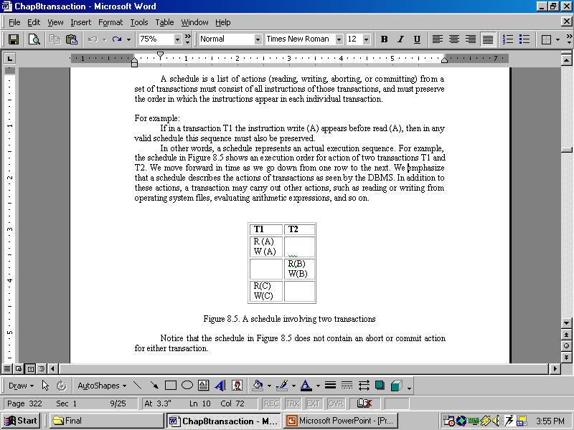


Slide 39

Complete Schedule
A schedule that contains either an abort or a commit for each transaction whose actions are listed in it is called a complete schedule. A complete schedule must contain all the actions of every transaction that appears in it.
Serial Schedule
Each serial schedule consists of a sequence of instructions from various transactions, where the instructions belonging to one single transaction appear together in that schedule. If the actions of different transactions are not interleaved-that is, transactions are executed from start to finish, one by one-- we call that schedule a serial schedule.

Slide 40
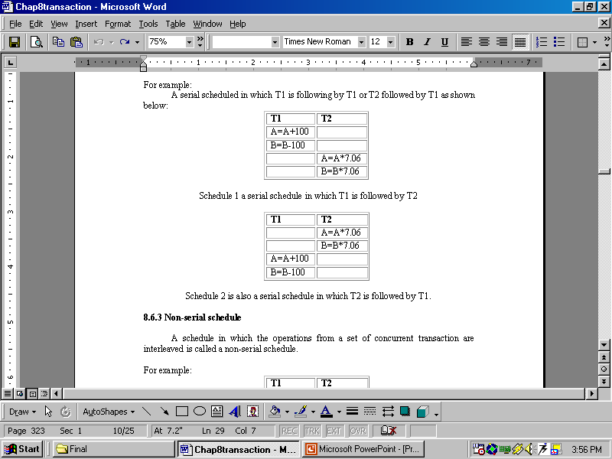


Slide 41
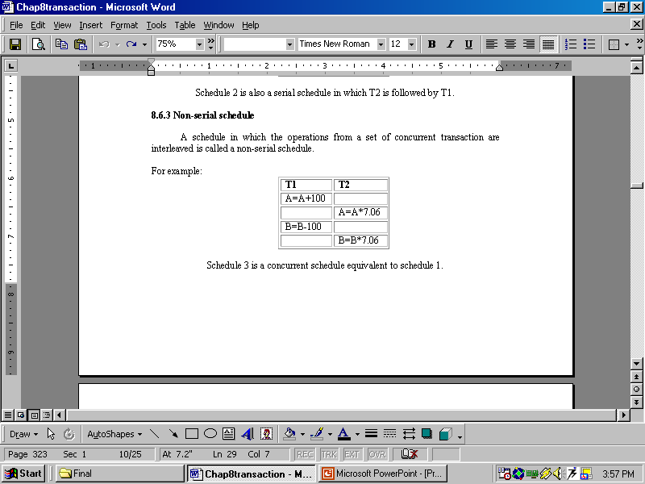
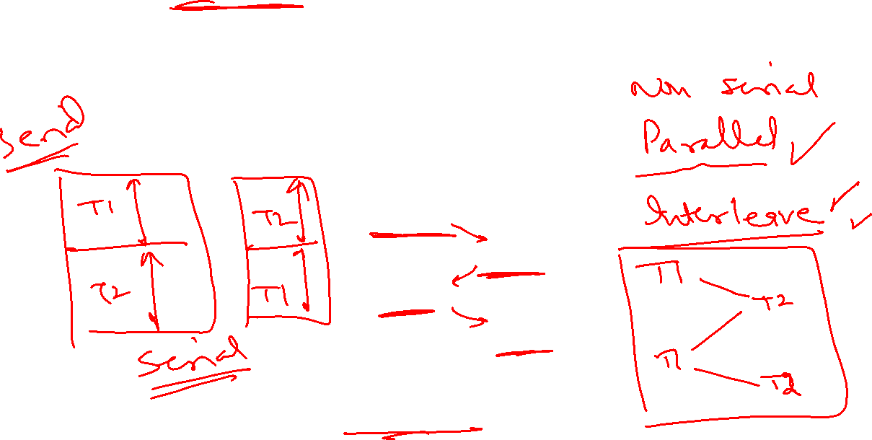

Slide 42
Equivalent Schedule For any database state, the effect (on the set of objects in the database) of executing the first schedule is identical to the effect of executing the second schedule.
For example Schedule-3 is equivalent schedule to Schedule-1.
Serializiable Schedule
A non-serial schedule that is equivalent to some serial execution of transactions is called a serializiable schedule. For example schedule-3 is serializable schedule, which is equivalent to schedule-1.
The objective of serializability is to find non-serial schedules that allow transactions to execute concurrently without interfering with one another, and thereby produce a database state that could be produced by a serial execution.

Slide 43
CONFLICTS OF OPERATIONS
Those read/write operations whose order cannot be changed without affecting the consistency of data are called Conflict Operations.
There are some rules to define conflict operations. These are:
If two transactions only read a data object, they do not conflict and the order is not important.
If two transactions either read or write completely separate data objects, they do not conflict and the order is not important.
If one transaction writes a data object and another either reads or writes the same data object, the order of execution is important.

Slide 44


Slide 48
PROBLEMS OF CONCURRENCY
OR TYPES OF CONFLICT OPERATIONS
When concurrent transactions (means when number of transactions access same piece of data at same time) executed in an uncontrolled manner, several problems can occur. The concurrency control has the following three main problems:
Lost updates or Overwriting Uncommitted Data: Write-Write Conflict
Dirty Read Problem or Reading Uncommitted Data: Write-Read Conflict
Unrepeatable Reads: Read-Write Conflict

Slide 49
Lost Update Problem (Overwriting Uncommitted Data): Write-Write Conflict
A lost update problem occurs when two transactions that access the same database items have their operations in a way that makes the value of some database item incorrect. In other words, if transactions T­1 and T2 both read a record and then update it, the effects of the first update will be overwritten by the second update. It occurs in case of write-write conflict.

Slide 53
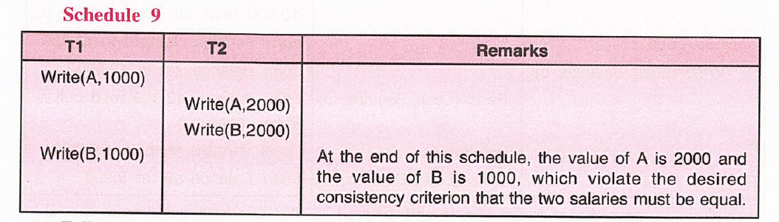

Slide 56
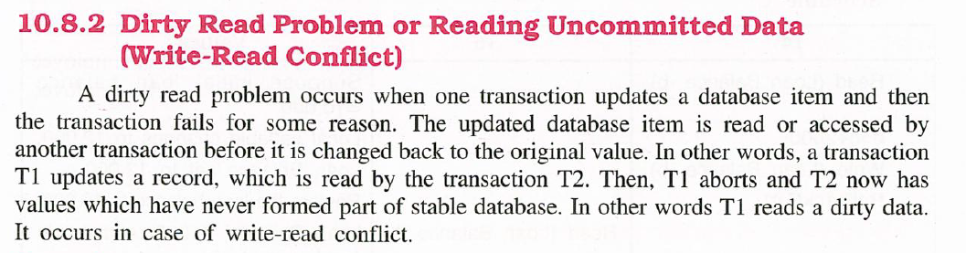

Slide 58
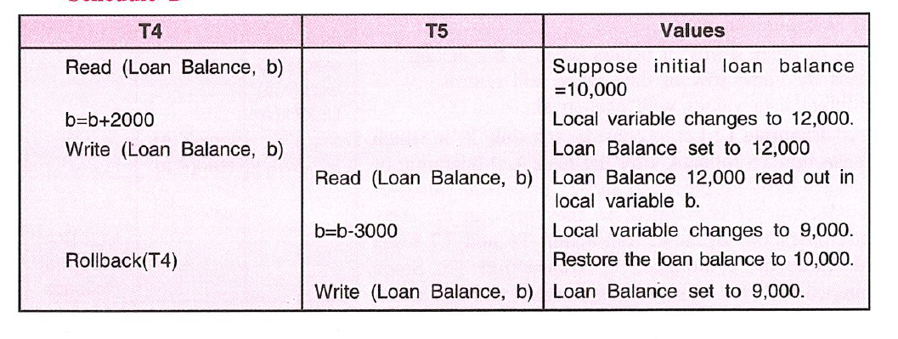

Slide 59
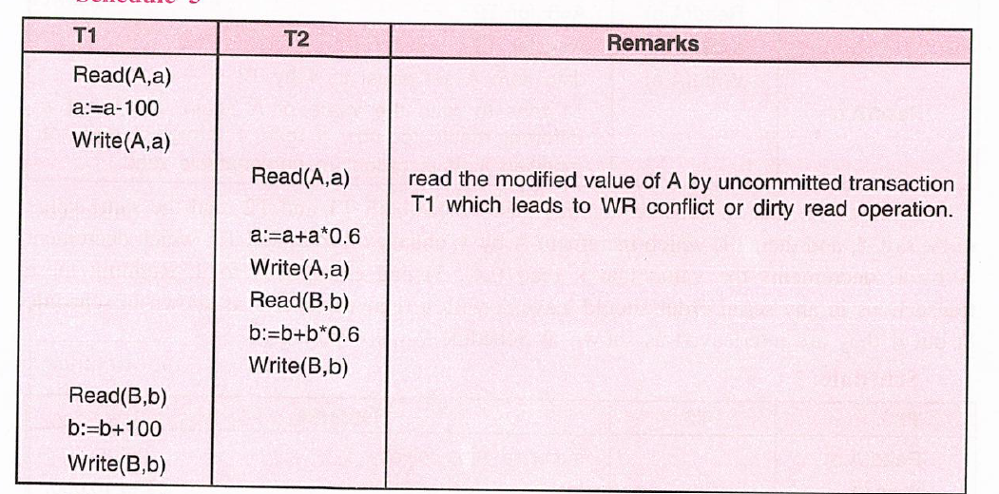

Slide 61
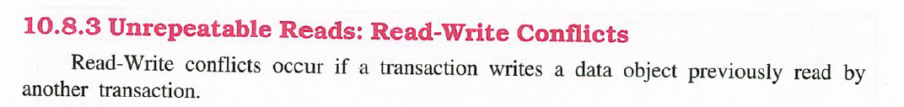

Slide 64
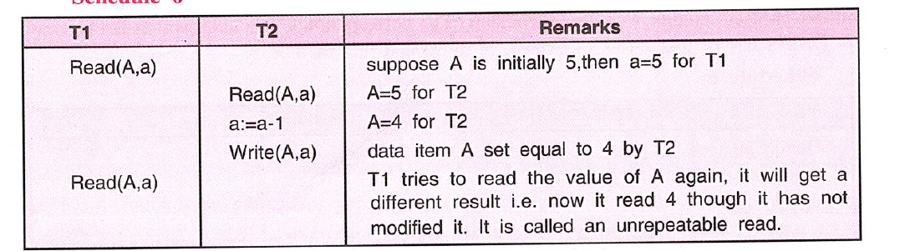

Slide 67
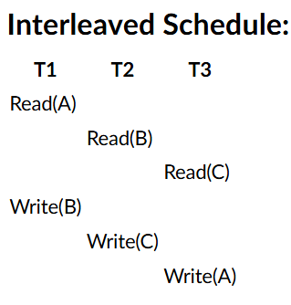
Construct Precedence Graph
In the precedence graph, nodes are transactions (T1, T2, T3), and edges are added from Ti to Tj if Ti's operation occurs before and conflicts with Tj's operation.
T2 → T1 [Because T2's Read(B) comes before T1's Write(B)]
T3 → T2 [Because T3's Read(C) comes before T2's Write(C)]
T1 → T3 [Because T1's Read(A) comes before T3's Write(A)]

Slide 68
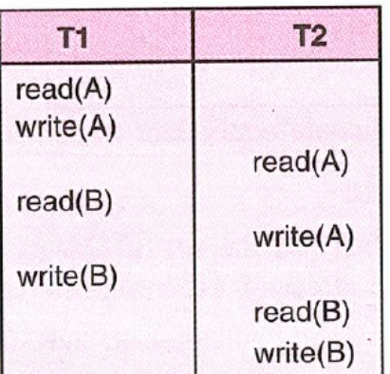
T1 → T2

